Slide 1
Foundations of Cryptography ElGamal encryption, plain RSA, RSA-OAEP, digital signature, hash-and-sign paradigm, plain RSA signature, RSA-FDH
LiangFeng Zhang
zhanglf@shanghaitech.edu.cn

Slide 2
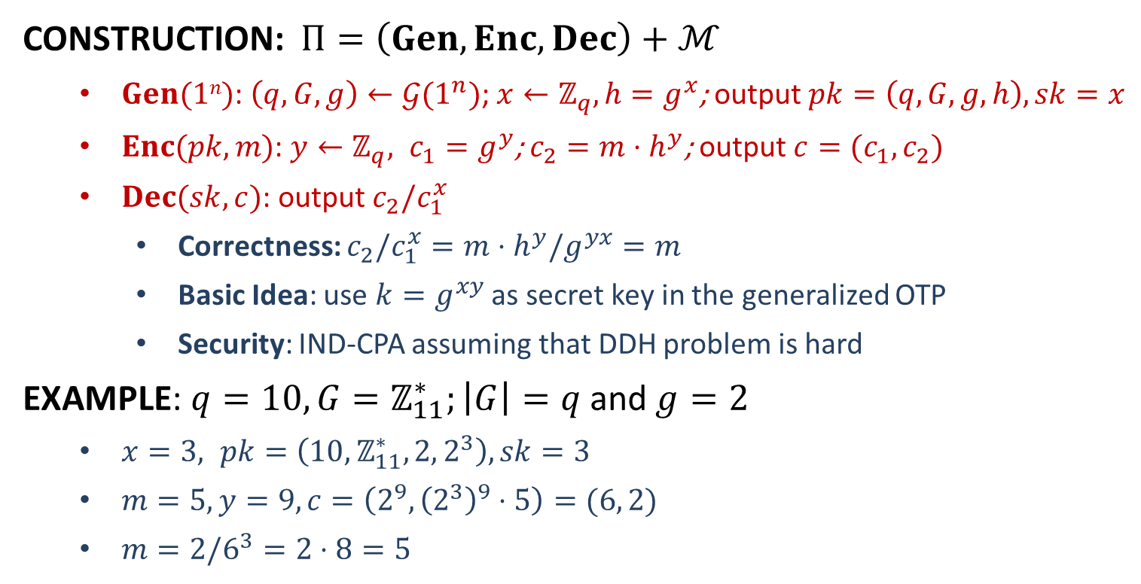
ElGamal Encryption
CONSTRUCTION: $Π=\left(Gen,Enc,Dec\right)+ℳ$
$Gen(1n)$: $\left(q,G,g\right)←𝒢(1^{n})$; $x←ℤ_{q}, h=g^{x}$; output $pk=\left(q,G,g,h\right), sk=x$
$Enc(pk, m)$: $y←ℤ_{q}, c_{1}=g^{y}$; $c_{2}=m⋅h^{y}$; output $c=(c_{1},c_{2})$
$Dec(sk, c)$: output $c_{2}/c_{1}^{x}$
Correctness: $c_{2}/c_{1}^{x}=m⋅h^{y}/g^{yx}=m$
Basic Idea: use $k=g^{xy}$ as secret key in the generalized OTP
Security: IND-CPA assuming that DDH problem is hard
EXAMPLE: $q=10, G=ℤ_{11}^{∗};\left|G\right|=q$ and $g=2$
$x=3, pk=\left(10,ℤ_{11}^{∗},2, 2^{3}\right), sk=3$
$m=5, y=9, c=\left(2^{9}, {\left(2^{3}\right)}^{9}⋅5\right)=(6, 2)$
$m=2/6^{3}=2⋅8=5$

Slide 3


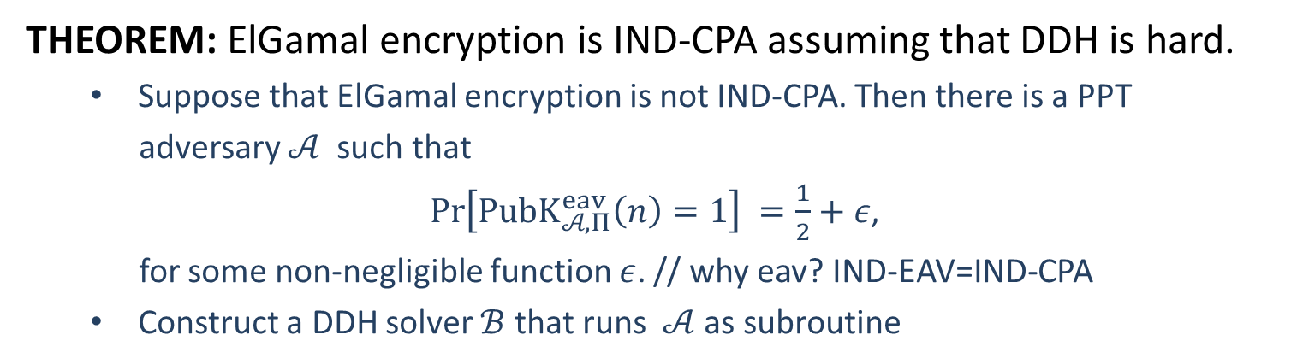





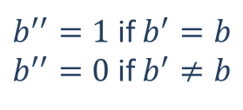

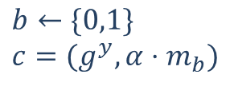

Security
THEOREM: ElGamal encryption is IND-CPA assuming that DDH is hard.
Suppose that ElGamal encryption is not IND-CPA. Then there is a PPT
adversary $𝒜$ such that
$\operatorname{Pr}\left[PubK_{𝒜, Π}^{eav}\left(n\right)=1\right] =\frac{1}{2}+ε$,
for some non-negligible function $ε$. // why eav? IND-EAV=IND-CPA
Construct a DDH solver $ℬ$ that runs $𝒜$ as subroutine
$$s=(q,G,g,g^{x},g^{y},α)$$
$α=g^{xy}$ or $α←G$
$$pk=(q,G,g,g^{x})$$
$$m_{0},m_{1}$$
$$b←\{0,1\}$$
$$c=(g^{y}, α⋅m_{b})$$
$$c$$
$$b′$$
$b^{′′}=1$ if $b^{′}=b$
$b^{′′}=0$ if $b^{′}≠b$
$$b^{′′}$$
$$ℬ$$
$$𝒜$$

Slide 4
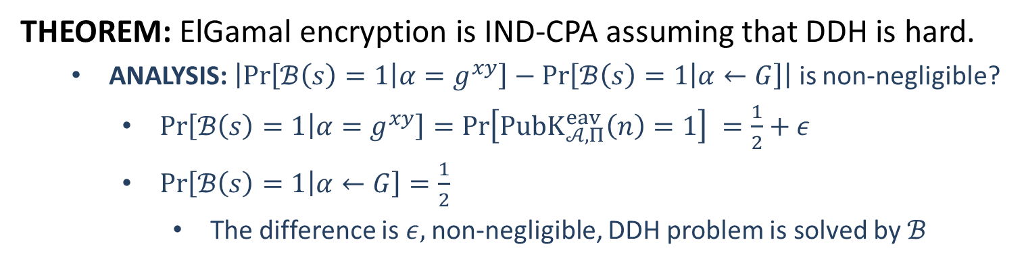
Security
THEOREM: ElGamal encryption is IND-CPA assuming that DDH is hard.
ANALYSIS: $\left|\operatorname{Pr}\left[ℬ\left(s\right)=1 | α=g^{xy}\right]−\operatorname{Pr}\left[ℬ\left(s\right)=1 | α←G\right]\right|$ is non-negligible?
$\operatorname{Pr}\left[ℬ\left(s\right)=1 | α=g^{xy}\right]=\operatorname{Pr}\left[PubK_{𝒜, Π}^{eav}\left(n\right)=1\right] =\frac{1}{2}+ε$
$\operatorname{Pr}\left[ℬ\left(s\right)=1 | α←G\right]=\frac{1}{2}$
The difference is $ε,$non-negligible, DDH problem is solved by $ℬ$
$$s=(q,G,g,g^{x},g^{y},α)$$
$α=g^{xy}$ or $α←G$
$$pk=(q,G,g,g^{x})$$
$$m_{0},m_{1}$$
$$b←\{0,1\}$$
$$c=(g^{y}, α⋅m_{b})$$
$$c$$
$$b′$$
$b^{′′}=1$ if $b^{′}=b$
$b^{′′}=0$ if $b^{′}≠b$
$$b^{′′}$$
$$ℬ$$
$$𝒜$$

Slide 6
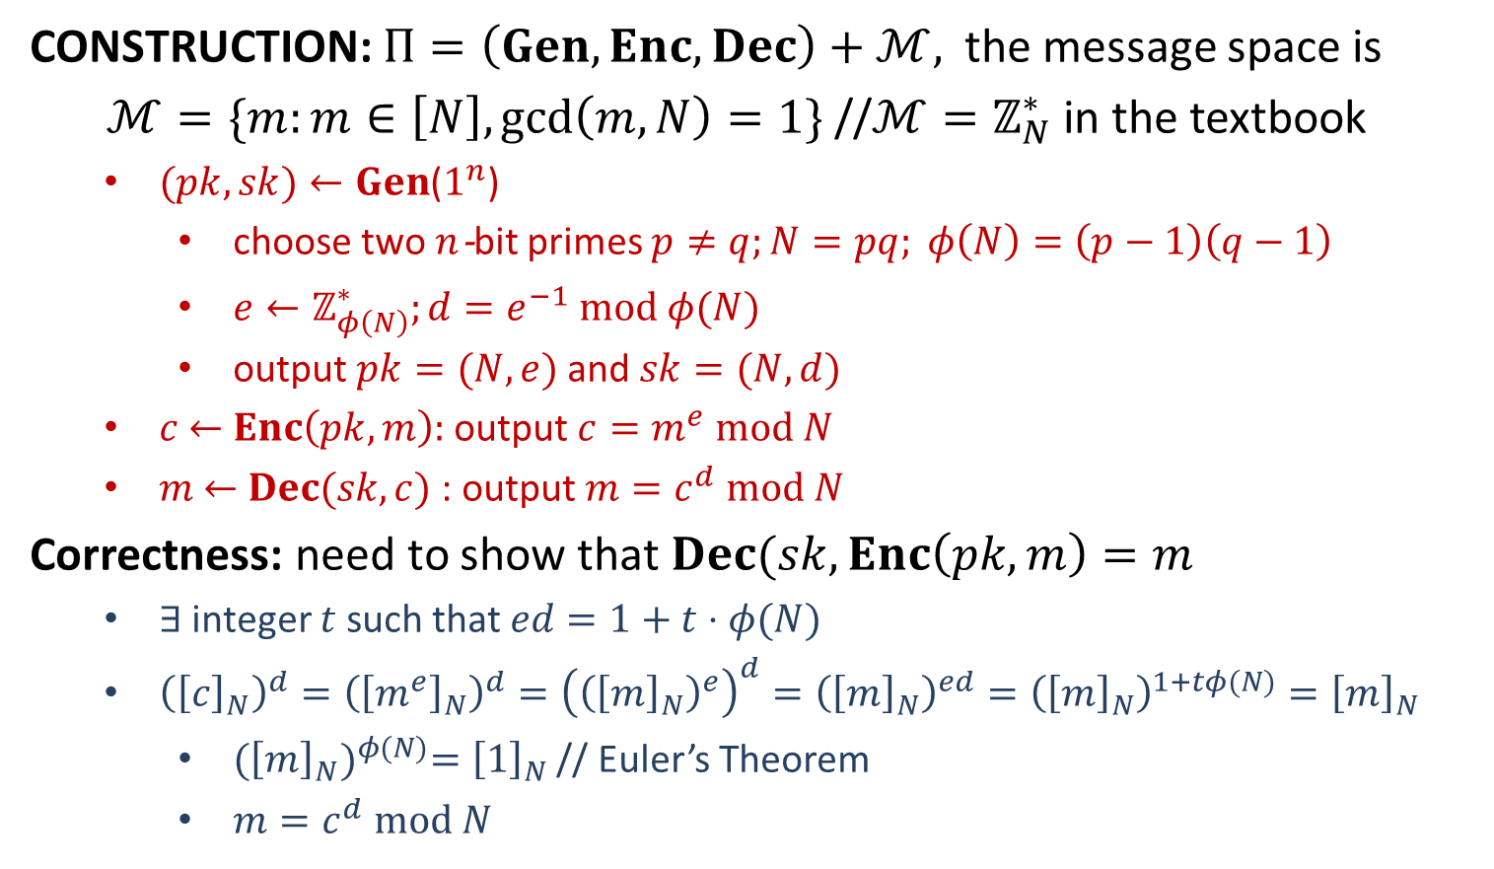
Plain RSA
CONSTRUCTION: $Π=\left(Gen,Enc,Dec\right)+ℳ,$the message space is
$ℳ=\{m:m∈\left[N\right],\gcd\left(m,N\right)=1\}$ //$ℳ=ℤ_{N}^{∗}$ in the textbook
$(pk, sk)←Gen$($1^{n}$)
choose two $n$-bit primes $p≠q;N=pq; φ\left(N\right)=\left(p−1\right)\left(q−1\right)$
$e←ℤ_{φ\left(N\right)}^{∗};d=e^{−1} mod φ(N)$
output $pk=(N, e)$and $sk=(N, d)$
$c$ $←$ $Enc\left(pk, m\right):$ output $c=m^{e} mod N$
$m$ $←$ $Dec(sk, c)$ : output $m=c^{d} mod N$
Correctness: need to show that $Dec(sk, Enc\left(pk,m\right)=m$
$∃$ integer $t$ such that $ed=1+t⋅φ(N)$
${\left({\left[c\right]}_{N}\right)}^{d}={\left({\left[m^{e}\right]}_{N}\right)}^{d}={\left({\left({\left[m\right]}_{N}\right)}^{e}\right)}^{d}={\left({\left[m\right]}_{N}\right)}^{ed}={\left({\left[m\right]}_{N}\right)}^{1+tφ(N)}={\left[m\right]}_{N}$
${({\left[m\right]}_{N})}^{φ(N)}={\left[1\right]}_{N}$ // Euler’s Theorem
$m=c^{d} mod N$

Slide 7
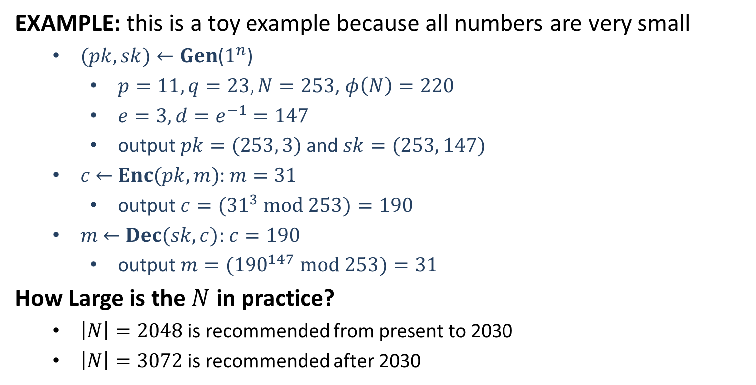
Plain RSA
EXAMPLE: this is a toy example because all numbers are very small
$(pk, sk)←Gen$($1^{n}$)
$p=11, q=23,N=253$, $φ\left(N\right)=220$
$e=3, d=e^{−1}=147$
output $pk=(253, 3)$and $sk=(253, 147)$
$c$ $←$ $Enc(pk, m)$: $m=31$
output $c=({31}^{3} mod 253)=190$
$m$ $←$ $Dec(sk, c)$: $c=190$
output $m=({190}^{147} mod 253)=31$
How Large is the $N$ in practice?
$\left|N\right|=2048$ is recommended from present to 2030
$\left|N\right|=3072$ is recommended after 2030

Slide 8
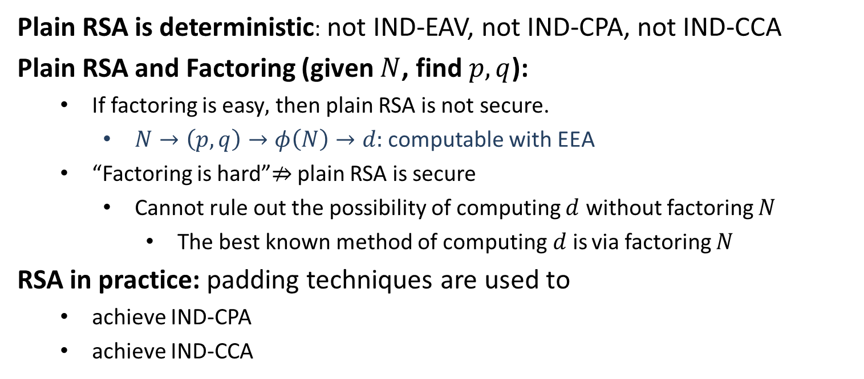
Security
Plain RSA is deterministic: not IND-EAV, not IND-CPA, not IND-CCA
Plain RSA and Factoring (given $N$, find $p,q$):
If factoring is easy$,$ then plain RSA is not secure.
$N→\left(p,q\right)→φ\left(N\right)→d:$ computable with EEA
“Factoring is hard”$⇏$ plain RSA is secure
Cannot rule out the possibility of computing $d$ without factoring $N$
The best known method of computing$d$is via factoring $N$
RSA in practice: padding techniques are used to
achieve IND-CPA
achieve IND-CCA

Slide 9


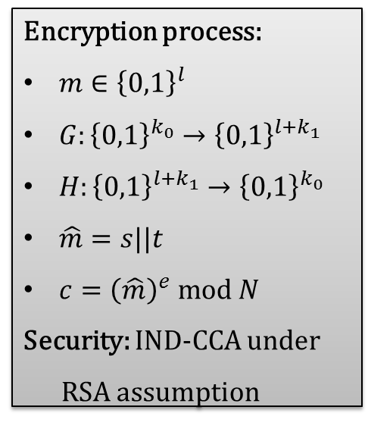
RSA-OAEP
RSA Optimal Asymmetric Encryption Padding: Variant of padded RSA,
part of the RSA PKCS #1 since version 2.0
Encryption process:
$m∈{\left\{0,1\right\}}^{l}$
$G:{\left\{0,1\right\}}^{k_{0}}→{\left\{0,1\right\}}^{l+k_{1}}$
$H:{\left\{0,1\right\}}^{l+k_{1}}→{\left\{0,1\right\}}^{k_{0}}$
$\hat{m}=s||t$
$c={\left(\hat{m}\right)}^{e} mod N$
Security: IND-CCA under
RSA assumption
$l+k_{1}$ bits
$k_{0}$ bits

Slide 10
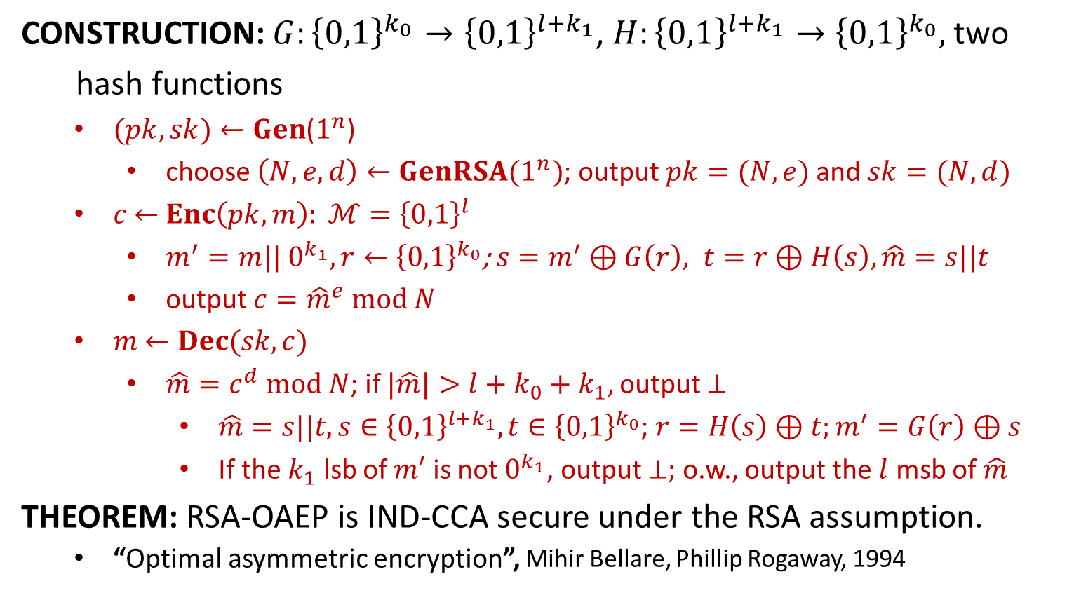
RSA-OAEP
CONSTRUCTION: $G:{\left\{0,1\right\}}^{k_{0}}→{\left\{0,1\right\}}^{l+k_{1}}$, $H:{\left\{0,1\right\}}^{l+k_{1}}→{\left\{0,1\right\}}^{k_{0}},$two
hash functions
$(pk, sk)←Gen$($1^{n}$)
choose $\left(N,e,d\right)←GenRSA(1^{n})$; output $pk=(N, e)$and $sk=(N, d)$
$c$ $←$ $Enc\left(pk, m\right): ℳ={\left\{0,1\right\}}^{l}$
$m^{′}=m|| 0^{k_{1}}, r←{\left\{0,1\right\}}^{k_{0}}$; $s=m^{′}⊕G\left(r\right), t=r⊕H\left(s\right), \hat{m}=s||t$
output $c={\hat{m}}^{e} mod N$
$m$ $←Dec(sk, c)$
$\hat{m}=c^{d} mod N$; if $|\hat{m}|>l+k_{0}+k_{1},$output $⊥$
$\hat{m}=s||t, s∈{\left\{0,1\right\}}^{l+k_{1}}, t∈{\left\{0,1\right\}}^{k_{0}}$; $r=H\left(s\right)⊕t;m^{′}=G\left(r\right)⊕s$
If the $k_{1}$ lsb of $m′$ is not $0^{k_{1}}$, output $⊥;$ o.w., output the $l$ msb of $\hat{m}$
THEOREM: RSA-OAEP is IND-CCA secure under the RSA assumption.
“Optimal asymmetric encryption”, Mihir Bellare, Phillip Rogaway, 1994

Slide 12


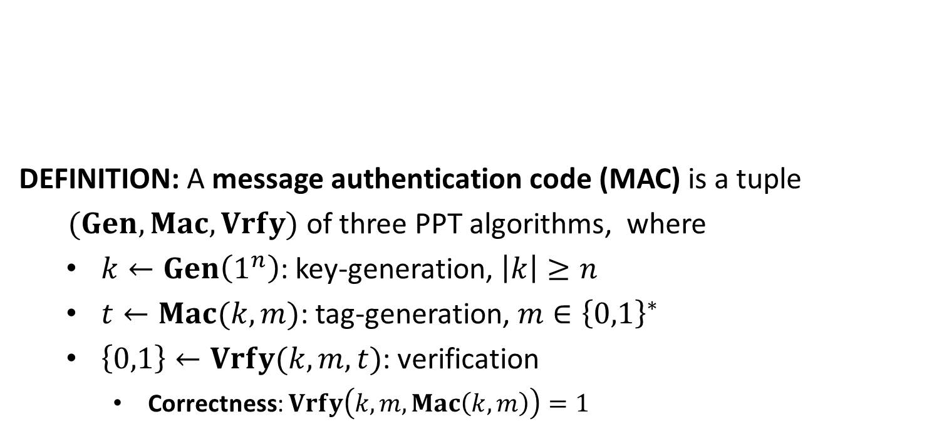




Message Authentication Code
DEFINITION: A message authentication code (MAC) is a tuple
$(Gen, Mac,Vrfy)$ of three PPT algorithms, where
$k←Gen\left(1^{n}\right)$: key-generation, $\left|k\right|≥n$
$t←Mac(k,m)$: tag-generation, $m∈{\left\{0,1\right\}}^{∗}$
$\left\{0,1\right\}←Vrfy(k,m,t)$: verification
Correctness: $Vrfy\left(k,m,Mac\left(k,m\right)\right)=1$
message $m$
tag $t$
$$k$$
$$k$$

Slide 13

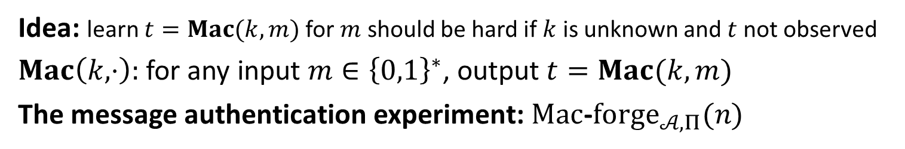

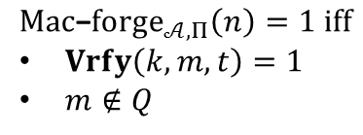





Security
Idea: learn $t=Mac(k,m)$ for $m$ should be hard if $k$ is unknown and $t$ not observed
$Mac\left(k,⋅\right):$ for any input $m∈{\left\{0,1\right\}}^{∗}$, output $t=Mac(k,m)$
The message authentication experiment: $Mac$-$forge_{𝒜,Π}(n)$
$$k←Gen\left(1^{n}\right)$$
$$oracle access to$$
$$Mac(k,⋅)$$
$$Challenger$$
$$Adversary 𝒜$$
$$(m,t)$$
$$Mac\text{−}forge_{𝒜,Π}\left(n\right)=1 iff$$
$Vrfy\left(k,m,t\right)=1$
$m∉Q$
$Q:$ the set of messages queried by $𝒜$

Slide 14
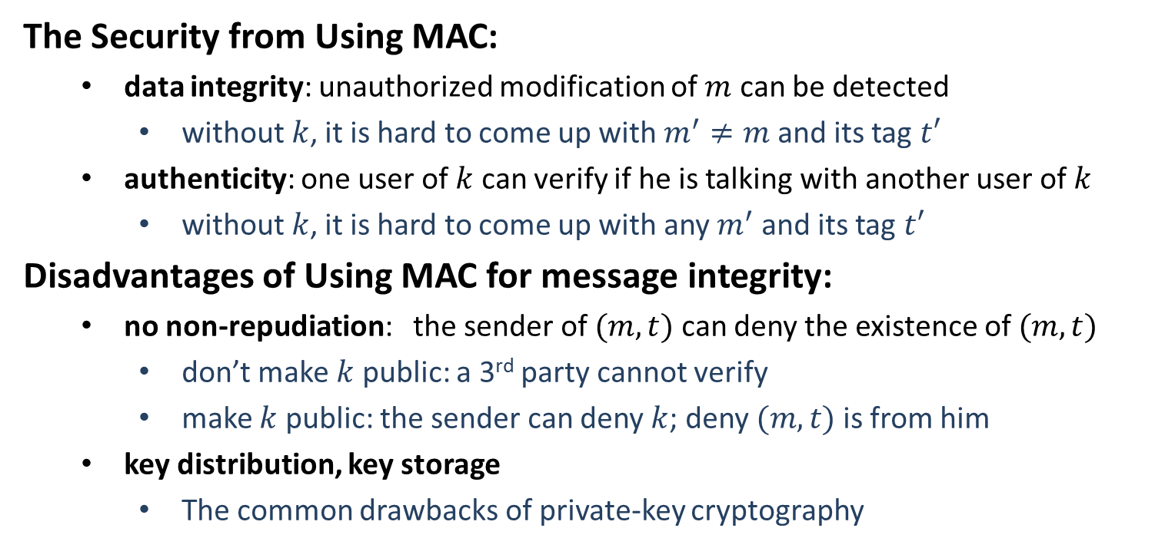
Security
The Security from Using MAC:
data integrity: unauthorized modification of $m$ can be detected
without$k$, it is hard to come up with $m^{′}≠m$ and its tag $t′$
authenticity: one user of $k$ can verify if he is talking with another user of $k$
without$k$, it is hard to come up with any $m^{′}$ and its tag $t′$
Disadvantages of Using MAC for message integrity:
no non-repudiation: the sender of $(m,t)$ can deny the existence of $(m,t)$
don’t make $k$ public: a 3rd party cannot verify
make $k$ public: the sender can deny $k$; deny $(m,t)$ is from him
key distribution, key storage
The common drawbacks of private-key cryptography

Slide 16

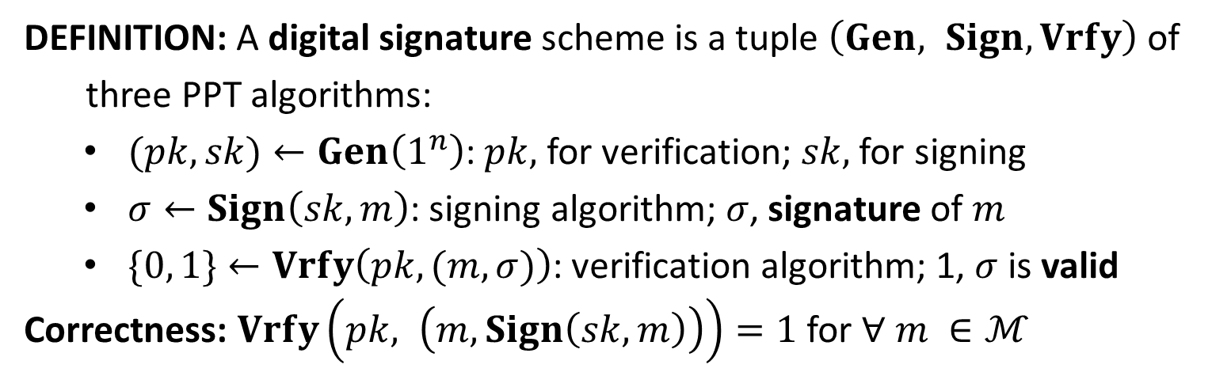


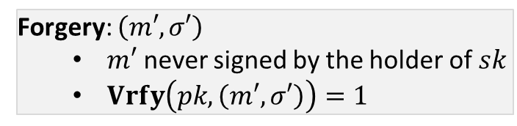


Digital Signature
DEFINITION: A digital signature scheme is a tuple $\left(Gen, Sign, Vrfy\right)$ of
three PPT algorithms:
$(pk,sk)←Gen\left(1^{n}\right)$: $pk,$ for verification; $sk,$ for signing
$σ←Sign\left(sk, m\right)$: signing algorithm; $σ$, signature of $m$
$\{0, 1\}←Vrfy\left(pk, (m,σ)\right)$: verification algorithm; 1, $σ$ is valid
Correctness: $Vrfy\left(pk, \left(m, Sign\left(sk,m\right)\right)\right)=1$ for $∀ m ∈ℳ$
$$(m, σ)$$
$$(m′, σ′)$$
$$?Vrfy\left(pk, \left(m, σ\right)\right)=1$$
Alice
Bob
Forgery: $\left(m′, σ′\right)$
$m′$ never signed by the holder of $sk$
$Vrfy\left(pk, \left(m′, σ′\right)\right)=1$
$$sk$$
A
$$pk$$

Slide 17








Security
The Signature Experiment $Sig−forge_{𝒜,Π}(n)$
$$(pk,sk)←Gen\left(1^{n}\right)$$
$$pk$$
$$orace access to$$
$$Challenger$$
$$Sign(sk,⋅)$$
$$Adversary 𝒜$$
$$(m,σ)$$
$$output 1 if and only if$$
$m never signed with sk$
$Vrfy\left(pk,\left(m,σ\right)\right)=1$

Slide 18
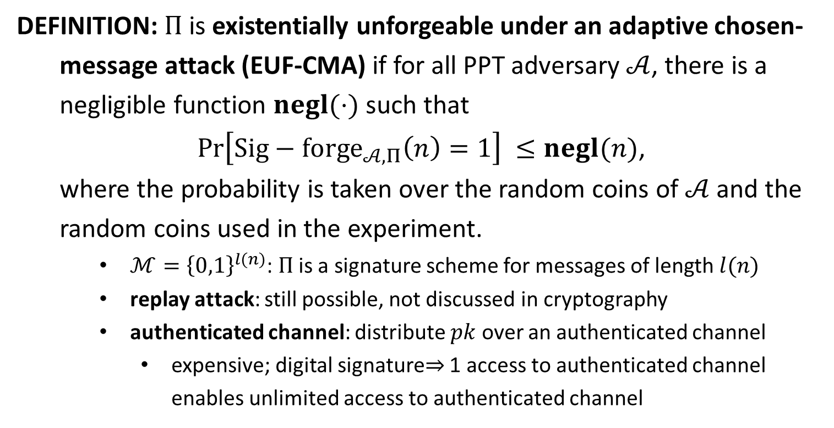
EUF-CMA
DEFINITION: $Π$is existentially unforgeable under an adaptive chosen-
message attack (EUF-CMA) if for all PPT adversary $𝒜$, there is a
negligible function $negl(⋅)$ such that
$\operatorname{Pr}\left[Sig−forge_{𝒜,Π}\left(n\right)=1\right] ≤negl(n)$,
where the probability is taken over the random coins of $𝒜$ and the
random coins used in the experiment.
$ℳ={\left\{0,1\right\}}^{l(n)}$: $Π$ is a signature scheme for messages of length $l(n)$
replay attack: still possible, not discussed in cryptography
authenticated channel: distribute $pk$ over an authenticated channel
expensive; digital signature$⇒$ 1 access to authenticated channel enables unlimited access to authenticated channel

Slide 19
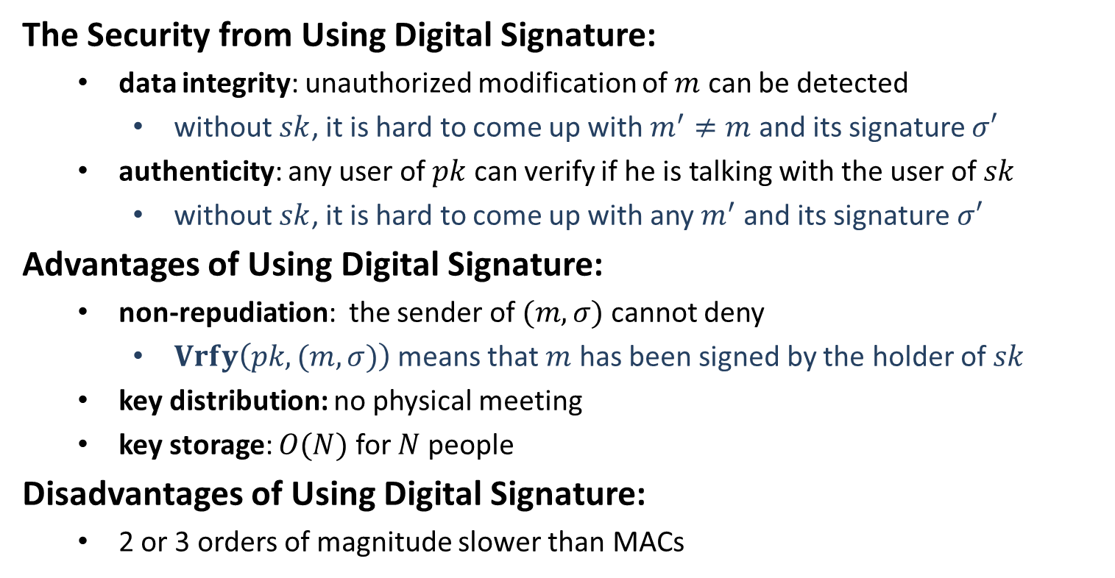
Security
The Security from Using Digital Signature:
data integrity: unauthorized modification of $m$ can be detected
without$sk$, it is hard to come up with $m^{′}≠m$ and its signature $σ′$
authenticity: any user of $pk$ can verify if he is talking with the user of $sk$
without$sk$, it is hard to come up with any $m^{′}$ and its signature $σ′$
Advantages of Using Digital Signature:
non-repudiation: the sender of $(m,σ)$ cannot deny
$Vrfy\left(pk, (m,σ)\right)$ means that $m$ has been signed by the holder of $sk$
key distribution: no physical meeting
key storage: $O(N)$ for $N$ people
Disadvantages of Using Digital Signature:
2 or 3 orders of magnitude slower than MACs

Slide 21
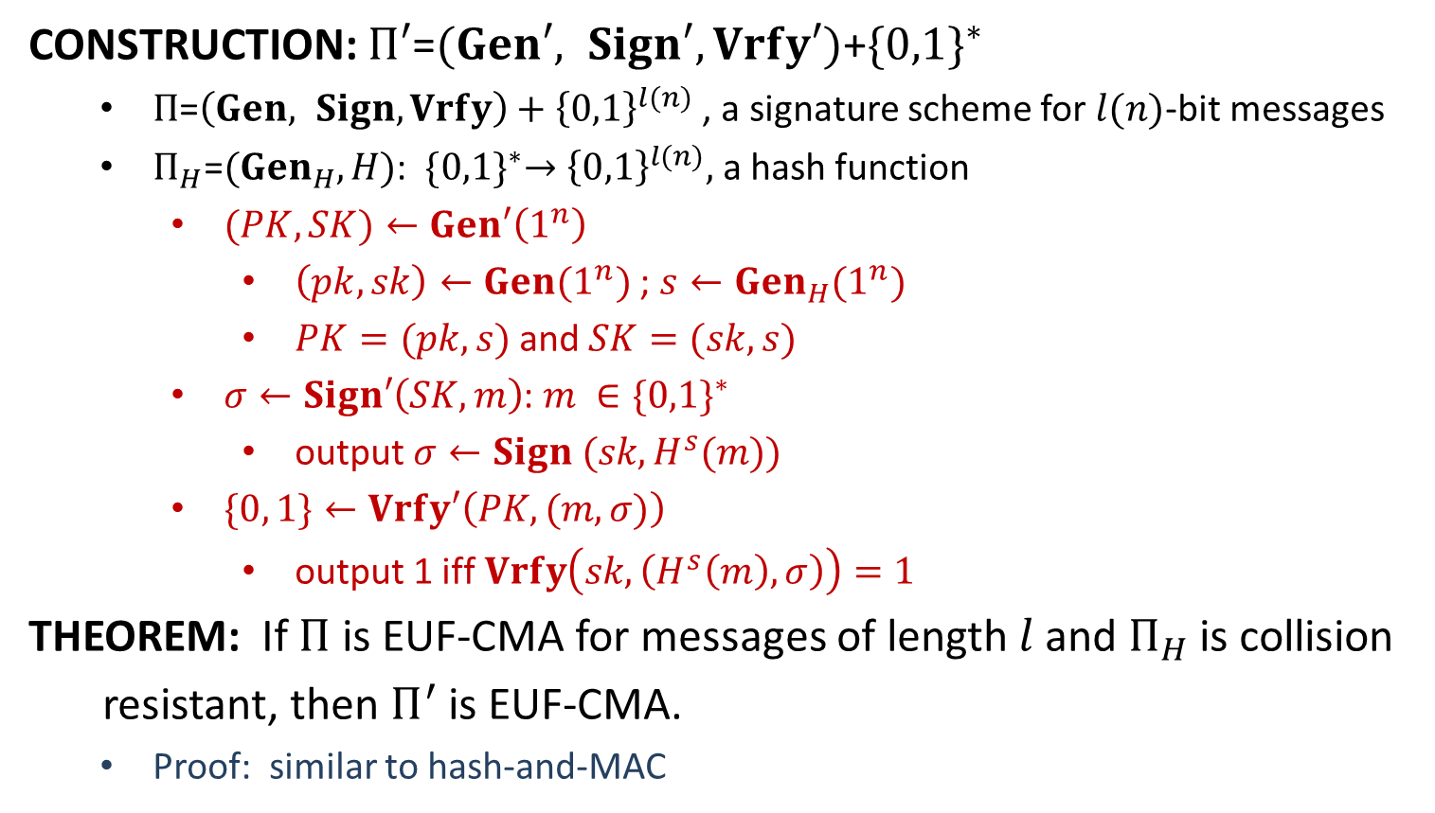
Hash-and-Sign Paradigm
CONSTRUCTION: $Π′\text{=}(Gen′, Sign′, Vrfy′)\text{+}{\{0,1\}}^{∗}$
$Π\text{=}\left(Gen, Sign, Vrfy\right)+{\left\{0,1\right\}}^{l(n)}$ , a signature scheme for $l(n)$-bit messages
$Π_{H}\text{=}({Gen}_{H},H)$: ${\{0,1\}}^{∗}→{\left\{0,1\right\}}^{l(n)},$ a hash function
$(PK,SK)←Gen′\left(1^{n}\right)$
$\left(pk,sk\right)←Gen(1^{n})$; $s←{Gen}_{H}(1^{n})$
$PK=(pk, s)$and $SK=(sk, s)$
$σ←Sign′\left(SK, m\right)$: $m ∈{\{0,1\}}^{∗}$
output $σ←Sign (sk, H^{s}(m))$
$\{0, 1\}←Vrfy′\left(PK, (m,σ)\right)$
output 1 iff $Vrfy\left(sk, \left(H^{s}\left(m\right), σ\right)\right)=1$
THEOREM: If $Π$ is EUF-CMA for messages of length$l$and $Π_{H}$ is collision
resistant, then $Π^{′}$ is EUF-CMA.
Proof: similar to hash-and-MAC

Slide 22
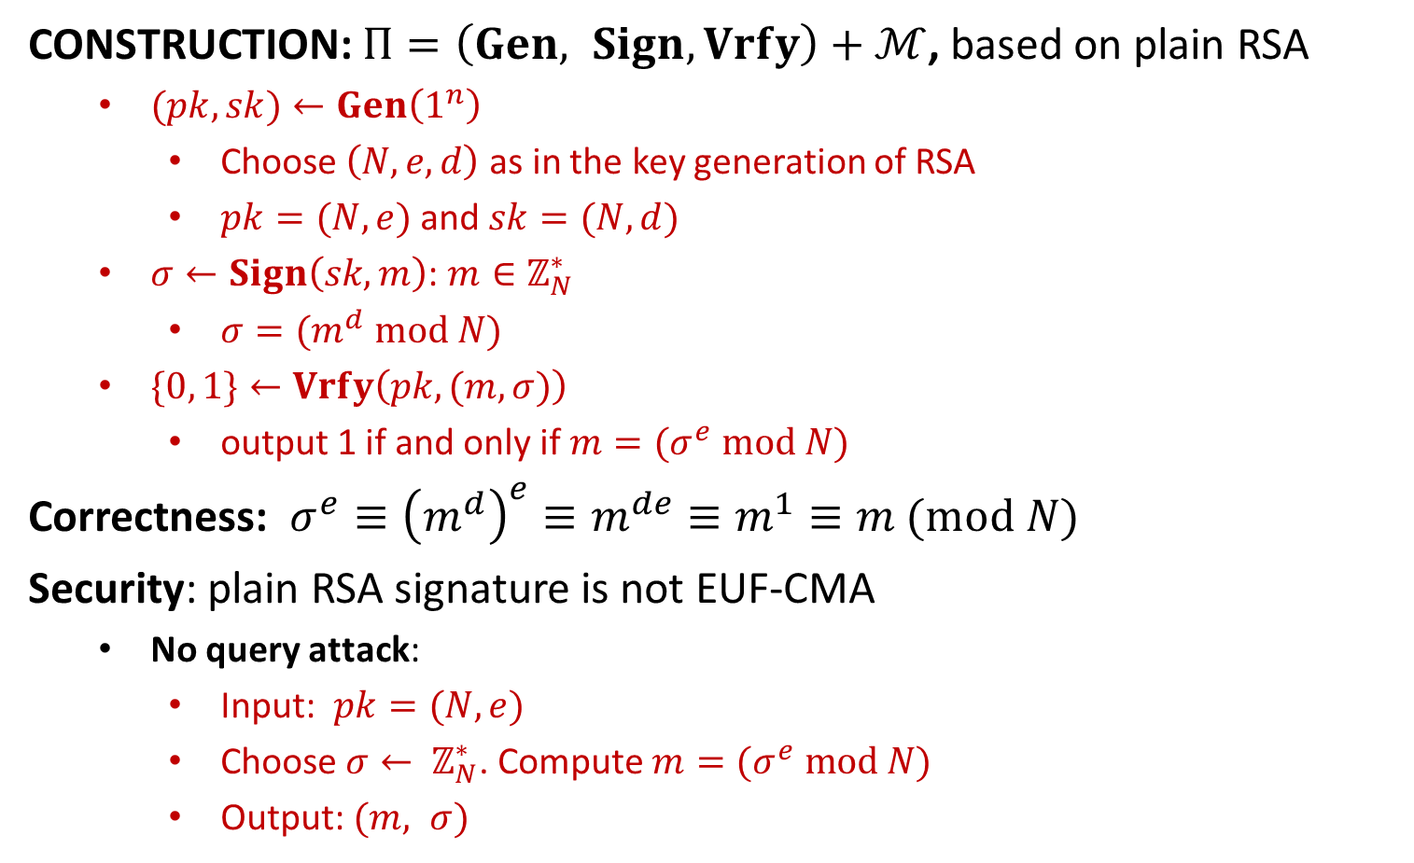
Plain RSA Signature
CONSTRUCTION: $Π=\left(Gen, Sign, Vrfy\right)+ℳ$, based on plain RSA
$(pk,sk)←Gen\left(1^{n}\right)$
Choose $\left(N,e,d\right)$ as in the key generation of RSA
$pk=(N, e)$and $sk=(N, d)$
$σ←Sign\left(sk, m\right)$: $m∈ℤ_{N}^{∗}$
$σ=(m^{d} mod N)$
$\{0, 1\}←Vrfy\left(pk, (m,σ)\right)$
output 1 if and only if $m=(σ^{e} mod N)$
Correctness: $σ^{e}≡{\left(m^{d}\right)}^{e}≡m^{de}≡m^{1}≡m (mod N)$
Security: plain RSA signature is not EUF-CMA
No query attack:
Input: $pk=(N,e)$
Choose $σ← ℤ_{N}^{∗}$. Compute $m=(σ^{e} mod N)$
Output: $(m, σ)$

Slide 23
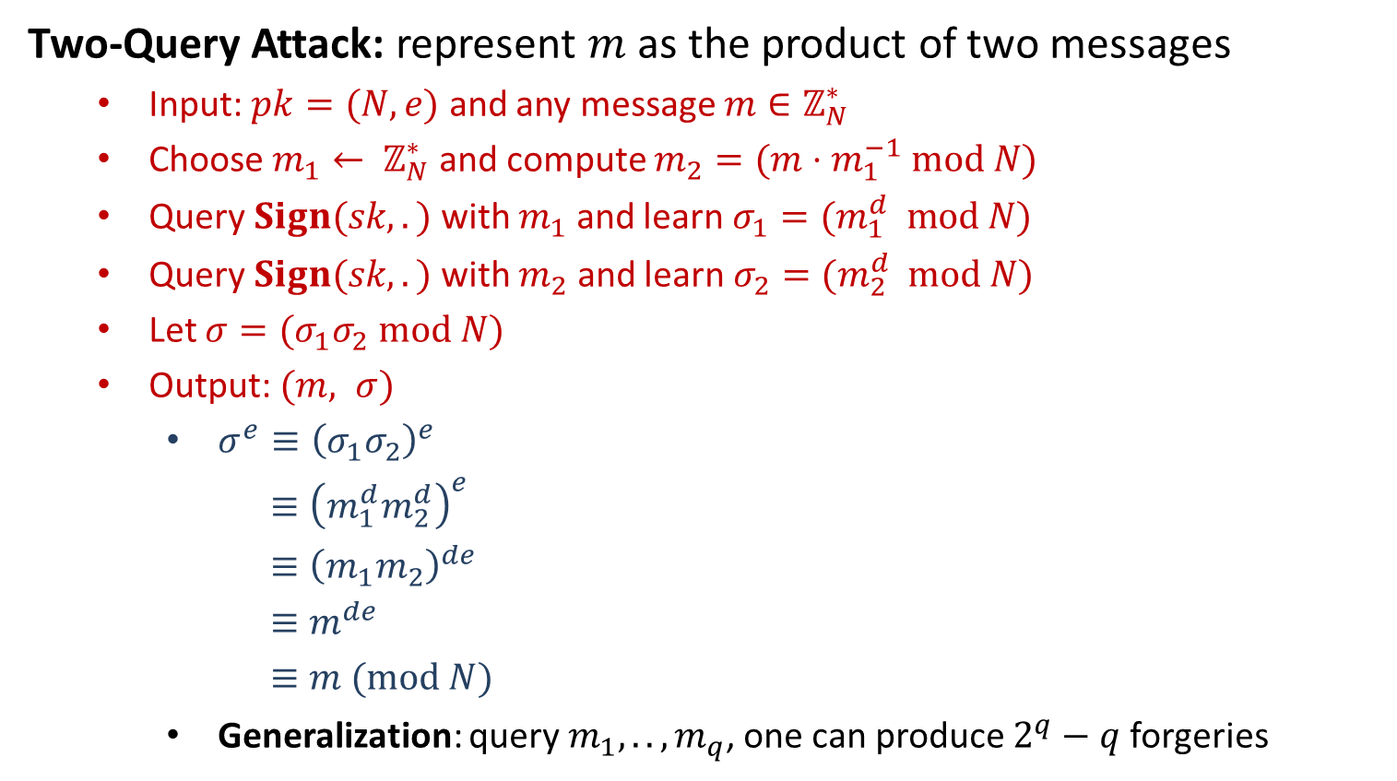
Plain RSA Signature
Two-Query Attack: represent $m$ as the product of two messages
Input: $pk=(N,e)$ and any message $m∈ℤ_{N}^{∗}$
Choose $m_{1}← ℤ_{N}^{∗}$ and compute $m_{2}=(m⋅m_{1}^{−1} mod N)$
Query $Sign(sk, .)$ with $m_{1}$ and learn $σ_{1}=(m_{1}^{d} mod N)$
Query $Sign(sk, .)$ with $m_{2}$ and learn $σ_{2}=(m_{2}^{d} mod N)$
Let $σ=(σ_{1}σ_{2} mod N)$
Output: $(m, σ)$
$σ^{e}≡{\left(σ_{1}σ_{2}\right)}^{e}$
$≡{\left(m_{1}^{d}m_{2}^{d}\right)}^{e}$
$≡{\left(m_{1}m_{2}\right)}^{de}$
$≡m^{de}$
$≡m (mod N)$
Generalization: query $m_{1},..,m_{q}$, one can produce $2^{q}−q$ forgeries

Slide 24
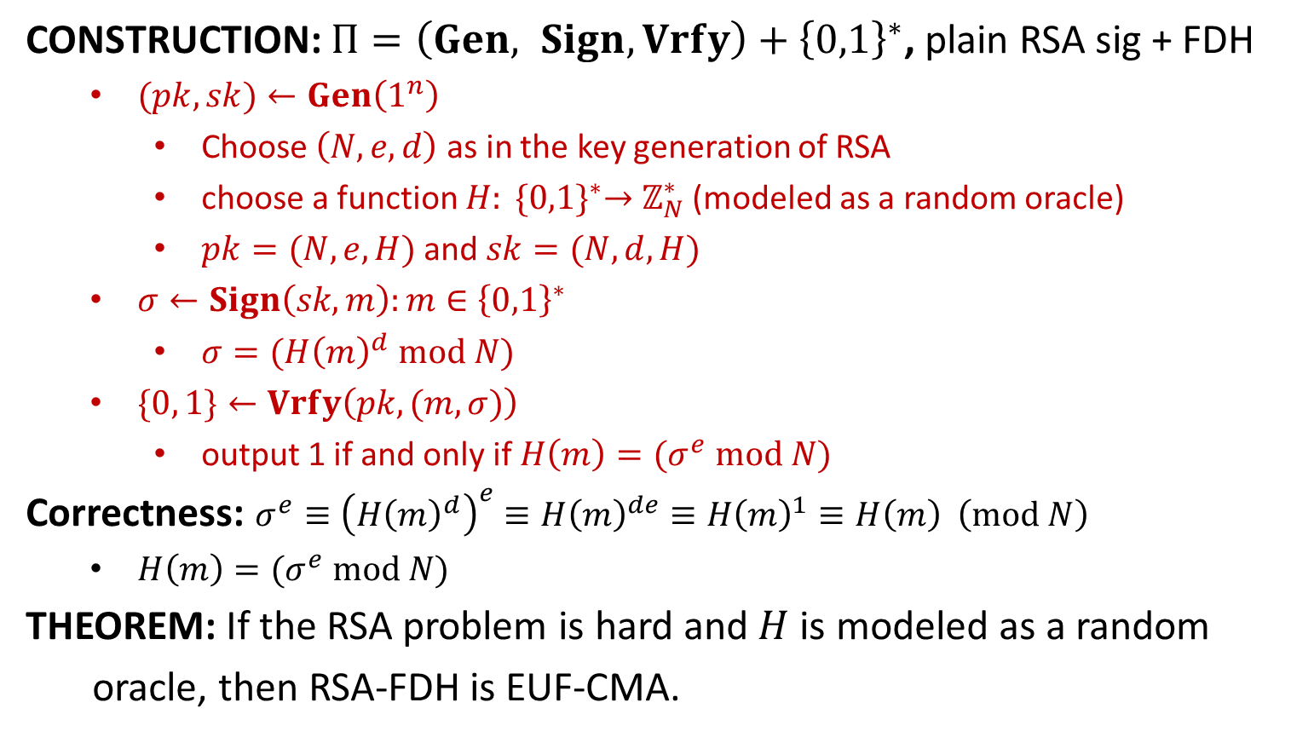
RSA-FDH (full-domain hash)
CONSTRUCTION: $Π=\left(Gen, Sign, Vrfy\right)+{\left\{0,1\right\}}^{∗}$, plain RSA sig + FDH
$(pk,sk)←Gen\left(1^{n}\right)$
Choose $\left(N,e,d\right)$ as in the key generation of RSA
choose a function $H: {\{0,1\}}^{∗}→$ $ℤ_{N}^{∗}$ (modeled as a random oracle)
$pk=(N, e, H)$and $sk=(N, d,H)$
$σ←Sign\left(sk, m\right):m∈{\left\{0,1\right\}}^{∗}$
$σ=({H\left(m\right)}^{d} mod N)$
$\{0, 1\}←Vrfy\left(pk, (m,σ)\right)$
output 1 if and only if $H\left(m\right)=(σ^{e} mod N)$
Correctness: $σ^{e}≡{\left({H\left(m\right)}^{d}\right)}^{e}≡{H\left(m\right)}^{de}≡{H\left(m\right)}^{1}≡H\left(m\right) \left(mod N\right)$
$H\left(m\right)=(σ^{e} mod N)$
THEOREM: If the RSA problem is hard and$H$is modeled as a random
oracle, then RSA-FDH is EUF-CMA.

Slide 26
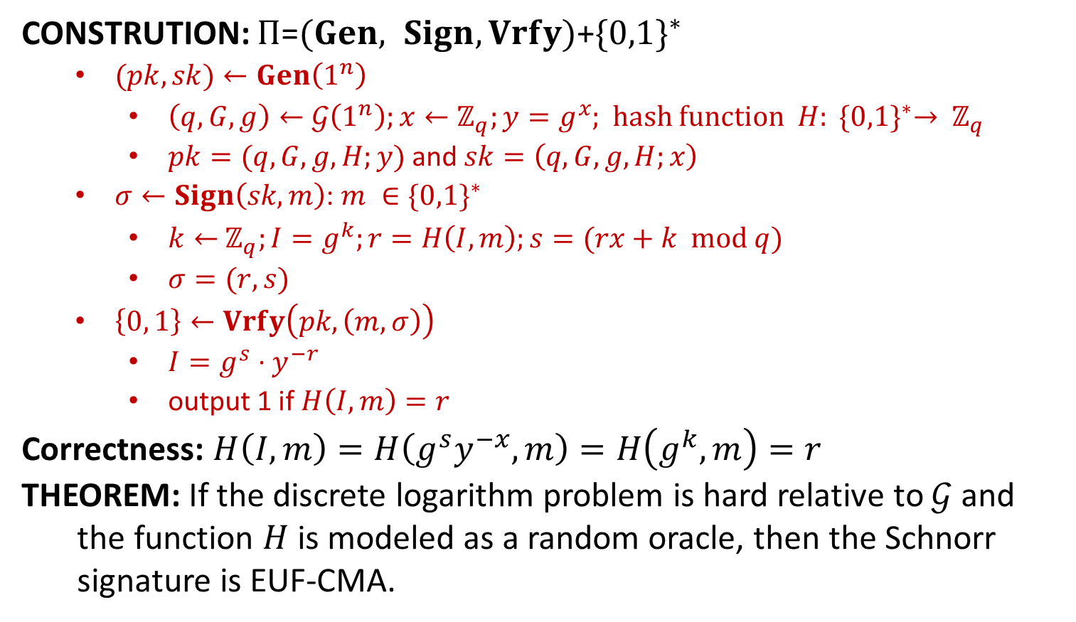
Schnorr Signature
CONSTRUTION: $Π\text{=}(Gen, Sign, Vrfy)\text{+}{\{0,1\}}^{∗}$
$(pk,sk)←Gen\left(1^{n}\right)$
$\left(q,G,g\right)←𝒢\left(1^{n}\right);x←ℤ_{q};y=g^{x}$; hash function $H: {\{0,1\}}^{∗}→ ℤ_{q}$
$pk=(q,G,g,H;y)$and $sk=\left(q,G,g,H;x\right)$
$σ←Sign\left(sk, m\right)$: $m ∈{\{0,1\}}^{∗}$
$k←$ $ℤ_{q};I=g^{k};r=H\left(I,m\right);s=(rx+k mod q)$
$σ=(r,s)$
$\left\{0, 1\right\}←Vrfy\left(pk, \left(m,σ\right)\right)$
$I=g^{s}⋅y^{−r}$
output 1 if $H\left(I,m\right)=r$
Correctness: $H\left(I,m\right)=H\left(g^{s}y^{−x},m\right)=H\left(g^{k},m\right)=r$
THEOREM: If the discrete logarithm problem is hard relative to $𝒢$ and
the function $H$ is modeled as a random oracle, then the Schnorr
signature is EUF-CMA.

Slide 27
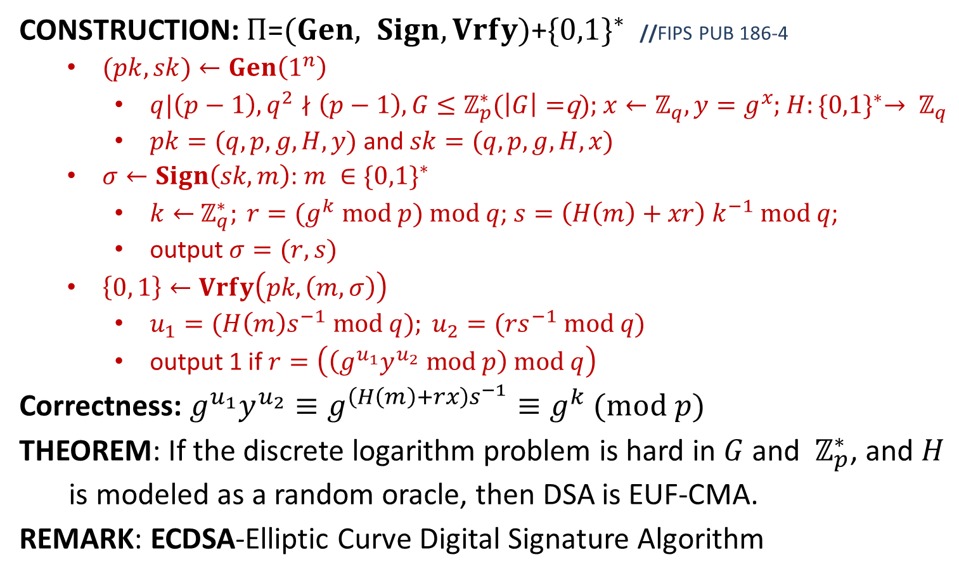
Digital Signature Algorithm
CONSTRUCTION: $Π\text{=}(Gen, Sign, Vrfy)\text{+}{\{0,1\}}^{∗}$ //FIPS PUB 186-4
$(pk,sk)←Gen\left(1^{n}\right)$
$q|\left(p−1\right), q^{2}∤\left(p−1\right), G≤ℤ_{p}^{∗}$($\left|G\right|=$q); $x←ℤ_{q}, y=g^{x}$; $H:{\{0,1\}}^{∗}→ ℤ_{q}$
$pk=(q,p,g,H,y)$and $sk=(q,p,g,H,x)$
$σ←Sign\left(sk, m\right)$: $m ∈{\{0,1\}}^{∗}$
$k←$ $ℤ_{q}^{∗}; r=(g^{k} mod p) mod q$; $s=\left(H\left(m\right)+xr\right) k^{−1} mod q$;
output $σ=(r,s)$
$\left\{0, 1\right\}←Vrfy\left(pk, \left(m,σ\right)\right)$
$u_{1}=(H\left(m\right)s^{−1} mod q); u_{2}=(rs^{−1} mod q)$
output 1 if $r=\left(\left(g^{u_{1}}y^{u_{2}} mod p\right) mod q\right)$
Correctness: $g^{u_{1}}y^{u_{2}}≡g^{\left(H\left(m\right)+rx\right)s^{−1}}≡g^{k} (mod p)$
THEOREM: If the discrete logarithm problem is hard in $G$ and $ℤ_{p}^{∗}$, and $H$
is modeled as a random oracle, then DSA is EUF-CMA.
REMARK: ECDSA-Elliptic Curve Digital Signature Algorithm

